Slide 1
ShuHaRi
Professor Ernesto Lee
Notes:
I happen to follow several tenets of buddhism even though I am not a buddhist. Once, I was living in Boston and I met a Monk named Ajohn John David and he introduced me to the concept of Shu Ha Ri. I never thought that a 1 hour conversation regarding Shu-Ha-Ri would change my life. Fast forward to today and I find that the distinct levels are useful when learning any new skill, including data centric skills like data analytics, data science, data engineering, etc. This is certainly not a new topic and also not one without some controversy either.

Slide 2
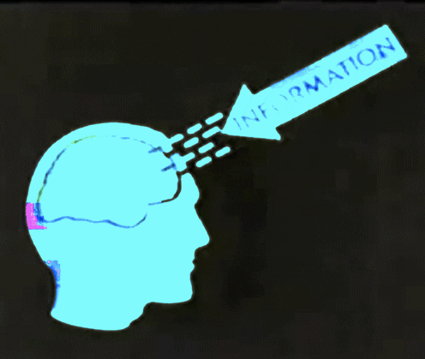
What is Shu Ha Ri?
Notes:
Shu Ha Ri is a Japanese martial art concept that is used to describe the stages of learning on the path to mastery. Aikido master teacher Endo Seishiro summarizes as follows:
“When we learn or train in something, we pass through the stages of shu, ha, and ri… In shu, we repeat the forms and discipline ourselves so that our mind simply absorbs the ideas that the masters of the subject created. We remain faithful to the teachings of the world's greatest minds - with no deviation.
Next, in the stage of ha, once we have disciplined our minds to acquire the core concepts created from the world's greatest minds… Only then do we make innovations. In this process the original ideas may be broken and discarded because you are exploring and growing beyond what you have learned.
Finally, in ri stage, we completely depart from the basics that we learned and we open the door to creative techniques, and arrive in a place where we act in accordance with what our heart and mind desires… You are unhindered and at the same time you are not overstepping laws.”

Slide 3

Shu
In this beginning stage the student follows the teachings of one master trainer or teacher or Professor precisely.
This requires trust in your institution and your teacher.
You concentrate only on how to do the task, without worrying too much about the underlying theory. If there are multiple variations on how to do the task, concentrate on just the one way the trainer, teacher or professor teaches you.

Slide 4
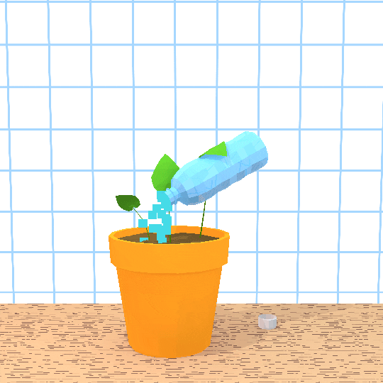
Ha
At this point the student begins to branch out.
With the basic practices working you now start to learn the underlying principles and theory behind the technique.
Before you were told to just click these buttons but in the Ha phase you begin to understand WHY.
You also start learning from other masters and integrate that learning into your practice.
You read. You google. You practice. You solve problems that you are interested in.

Slide 5

Ri
Now the student isn’t learning from other people, but from your own practice and experience.
You create your own approaches and adapt what you’ve learned to your own particular circumstances.
At this phase, you don’t know everything but you have mastered the basics AND you can apply that to solve new problems.

Slide 6

How Can I use Shu Ha Ri to learn about Data?
Essentially, start simple with the basics and do those well first.
With data, it always starts with understanding the structure of data.
You must know the data taxonomy.
Categorical, Binary, Ordinal, Real, Discrete. (Measures and Dimensions)
You must be able to wrangle your data.
You must be able to do a quality exploratory analysis which means you must understand Univariate Analysis, Bivariate and Multivariate analysis as well as Correlations and Covariance.
These are the basics. This is Shu.
Notes:
A simple but useful example: A student is unhappy with where they are in life and they have decided that come hell or high water they are going to change their circumstances. They realize that they are interested in Data and they want to develop a career in the data sciences. Here’s how the Shu Ha Ri progression can help.

Slide 7

Shu (Data Perspective)
A new Data Analyst changes their approach to follow the standard Analytics Process:
1) Understand the Data
2) Clean and Wrangle the Data And
3) Univariate, Bivariate, Multivariate Analysis and Correlation/Covariance.
Once the Analyst has deliberately followed this practice and exhibited a level of proficiency with it, they are highly likely to see marked improvements in the quality of their analysis as well as be able to discover deep insights within the data. Only then, worry about the tools.

Slide 8
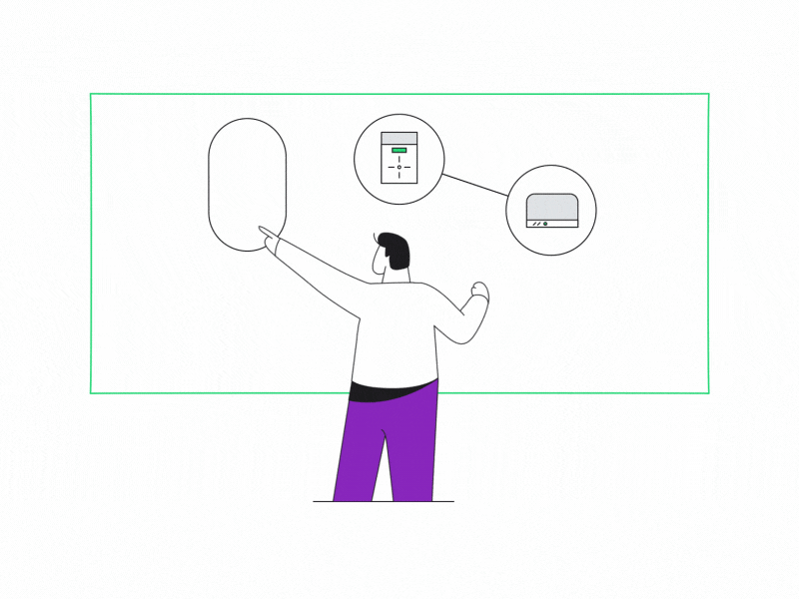
Ha (Data Perspective)
The Analyst is now very happy with the improvements they have made and are encouraged to make it better.
So, they start to loosen the language around the standard Data Analysis process and they then add a fourth statement: I will show the results as intuitive visuals and so they begin to show growth in Tableau and PowerBI and advance Excel or even just in Python.
This change starts to yield improvements in how the team collaborates with the business which results in the outcome of the Analysis being used to drive business decisions.
The analyst is now a core part of data driven decision making.

Slide 9

Ri (Data Perspective)
The Analyst has moved away from the mechanistic structure of data analysis (because they have mastered that) and their Analytics is more like a flow of information that everyone finds useful.
It is quick, concise, impactful, and adapts easily to the situation the business is facing.
The Analyst begins to discover shortcuts and starts to develop their own style.
Further and most importantly, the Analyst realizes that they can move beyond analyzing data and use the results of their analysis to make predictions with Machine Learning models.
This insight means that the Data Analyst is now in the Shu stage of Data Science.

Slide 10
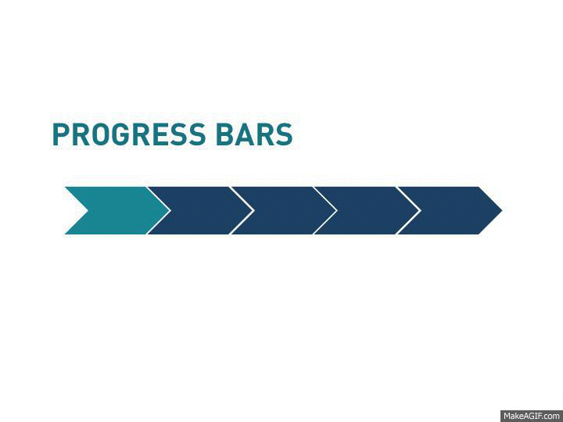
Why this progression?
In the example of an Analyst that only ever focused on following the instructions in a book, or video or a tutorial or what a teacher or professor told them, they would never move beyond Shu phase and would stop improving.
If they had just started experimenting with different questions and techniques and borrowing from other ideas, practices or disciplines (Ri), they would have never established their cadence.
Without the cadence, their Analysis likely would not have evolved and the insights would become predictable and not add value.

Slide 11

Here is the point…
Once you get the basics down, then move on to experimenting and looking to integrate new thoughts or ideas. Your experiments will lead you to new paths and eventually you’ll move beyond the specific practices and evolve your own way of doing things.

